Slide 1
Installing VMWare

Slide 2
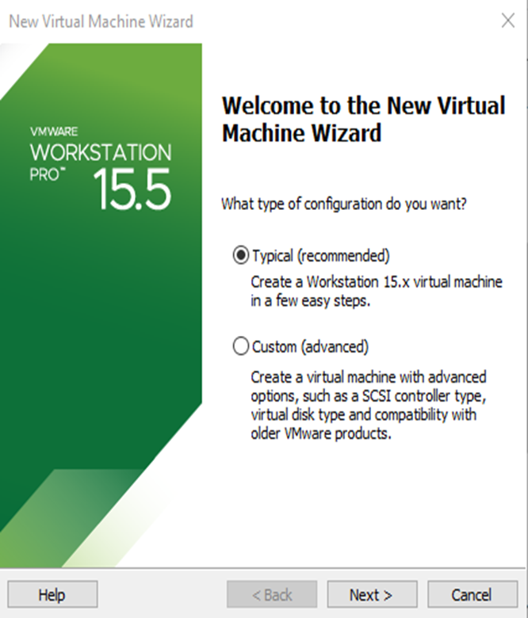
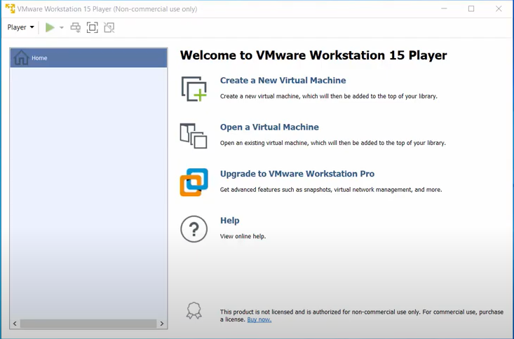
Note that your version of VMWare would be version 17.
Select the highlighted options.

Slide 3
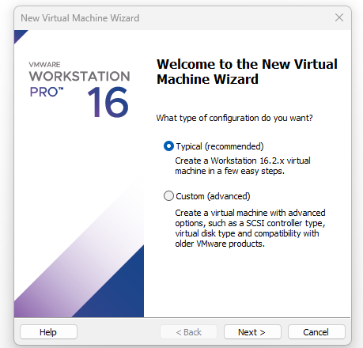
Locate and open the virtualisation software on your system as shown in screenshot below. We are using VMware workstation.

Slide 4
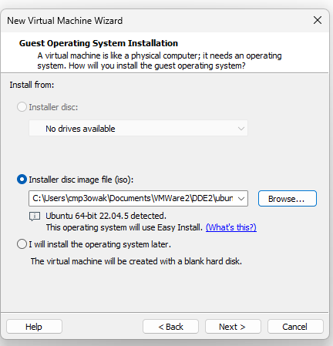
Locate and open the virtualisation software on your system as shown in screenshot below. We are using VMware workstation.
Do not select the option to install the O/S later.

Slide 5
Ubuntu Installation
To create new Virtual Machines on virtualisation software(VMware).
Click on File->New Virtual Machine.
Or
Type CTRL+N
This takes you to the New Virtual Machine Wizard as shown on the next slide

Slide 6
Comparison of Ubuntu 22.04 Desktop and Ubuntu Server for Resource Usage and User Experience.
NOTE:
Despite Ubuntu 22.04 Desktop requiring higher RAM due to its graphical user interface (GUI) and being less suitable for systems with limited memory, I prefer it for a better user experience, and the module is designed accordingly; whereas Ubuntu 22.04 Server is lightweight, lacks a GUI, and is better suited for systems with low RAM or minimal hardware resources.

Slide 7
Ubuntu Installation 22.04.5 Desktop (64-bit)
https://www.releases.ubuntu.com/releases/22.04.5/ubuntu-22.04.5-desktop-amd64.iso
https://ubuntu.com/download/alternative-downloads
Watch the video below to guide if you need assistance on installing.
https://www.youtube.com/watch?v=NhlhJFKmzpk

Slide 8
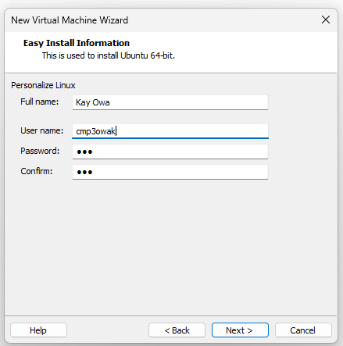
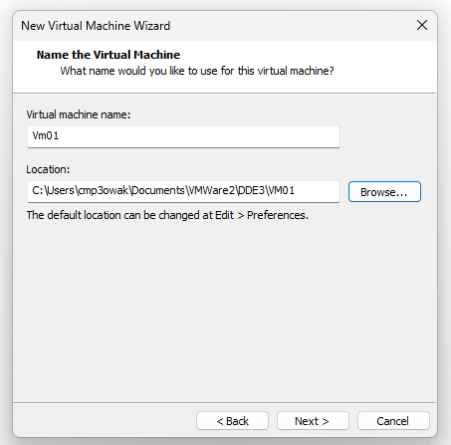
Complete as shown below with your details.

Slide 9
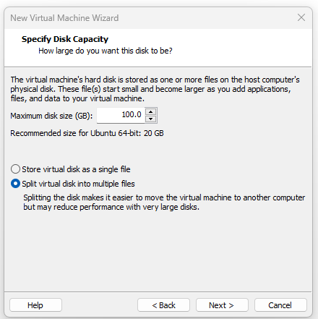
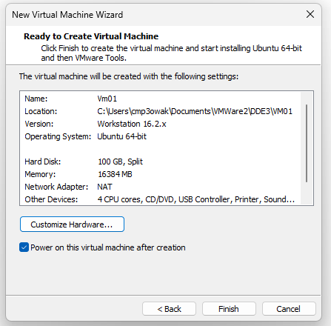
Complete as shown below with your details.
Click on Customise Hardware -> takes you to next slide

Slide 10
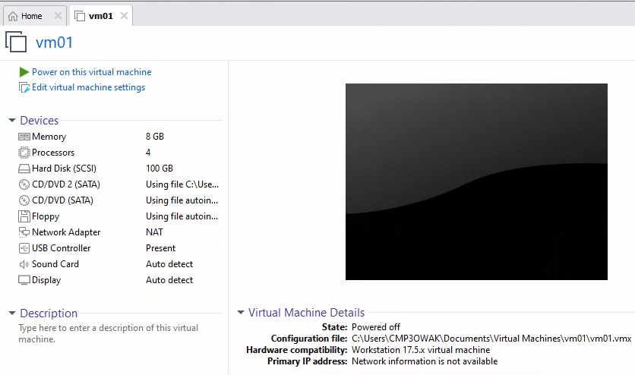
When creating multiple VMs, resource allocation must balance the needs of the VMs and the host machine. Allocate memory and CPUs based on the host's hardware capacity. For instance, if the host has 16 GB RAM and a quad-core processor, divide resources conservatively, such as 2–4 GB RAM and 1–2 CPUs per VM, ensuring the host retains enough for smooth operation.
Start with minimal allocations and scale up if performance issues arise. Use features like dynamic memory allocation where supported to optimize resource usage. Monitor both host and VM performance to avoid overloading the system. Ensure adequate disk space is available, with each VM having at least 100 GB, depending on the workload. Efficient resource planning ensures smooth performance for both the host and multiple VMs.

Slide 11
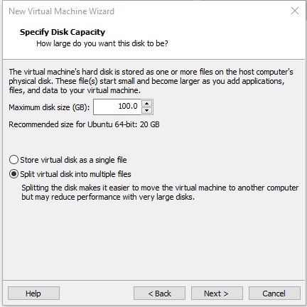
Complete the 2 sections as shown on the screenshot:
Confirm the amount of available hard disk space on the host machine before putting hard disk value.
Choose the split option for easy movement of VM files.
Click on Finish on the next screen.

Slide 12
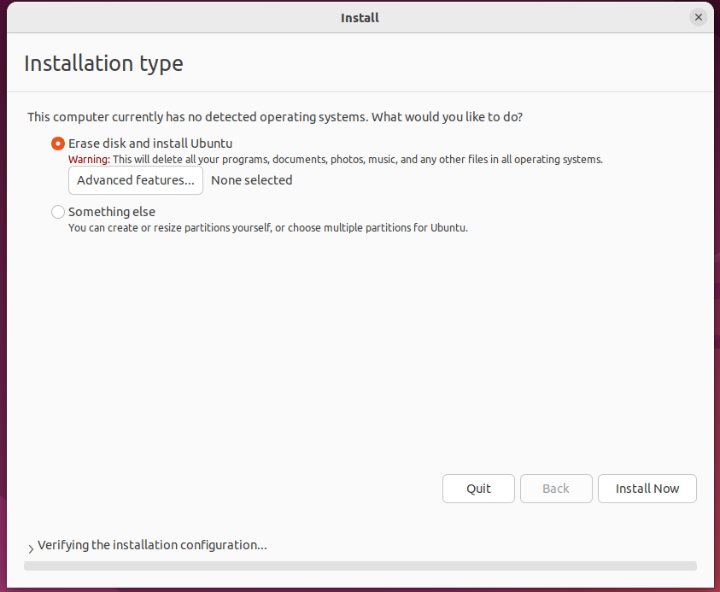
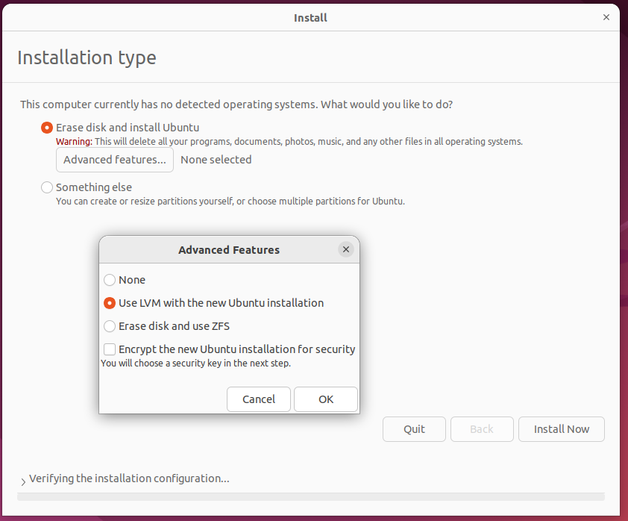
Follow screen instructions till you get to this screen

Slide 13
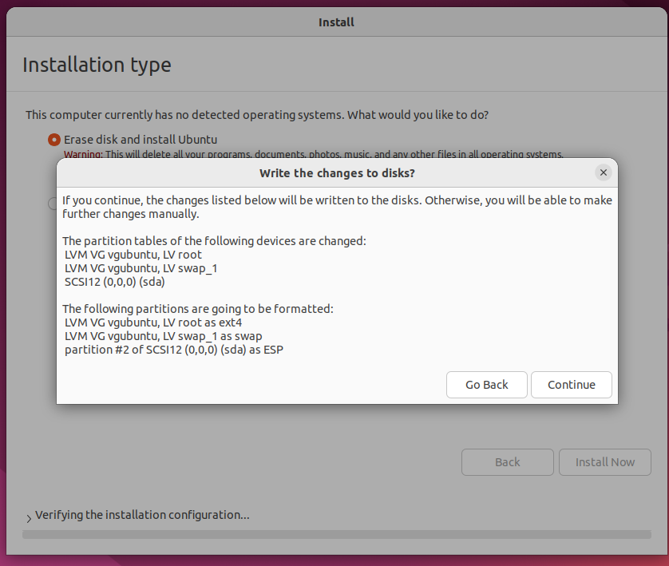
Follow screen instructions till you get to this screen

Slide 14
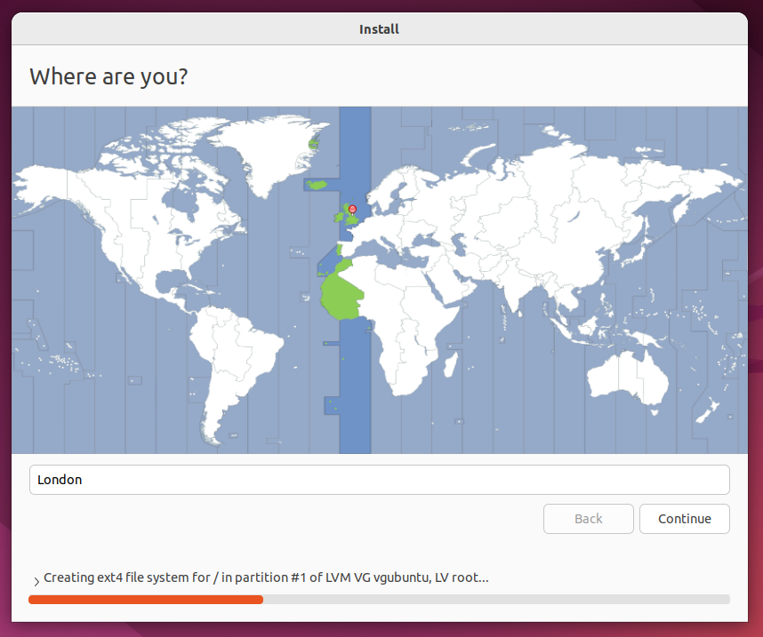
Follow screen instructions till you get to this screen

Slide 15
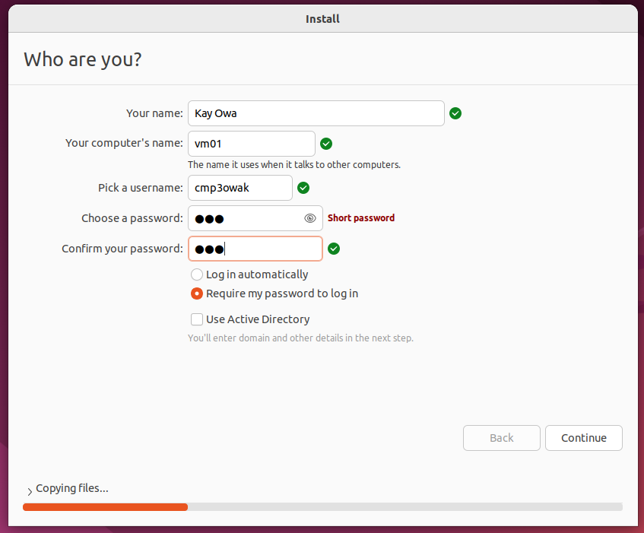
Follow screen instructions till you get to this screen

Slide 16
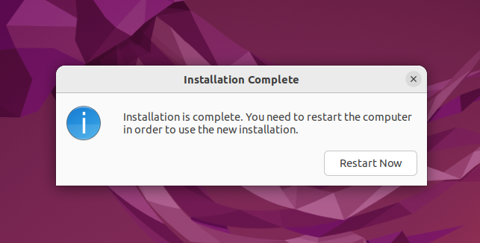
End of installation.
Restart to log in.
Click Skip for online accounts
Click next to continue.

Slide 17
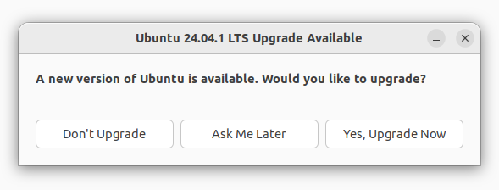
Important Notice:
Please do not proceed with the upgrade. The lab environment requires a specific version of Ubuntu that is compatible with all tasks and tools used in the lab. Upgrading to Ubuntu 24.04.1 LTS may introduce compatibility issues with the software and configurations currently in use.
Choose "Don't Upgrade" to maintain the required version for your lab work. If you have questions, please contact your instructor .

Slide 18
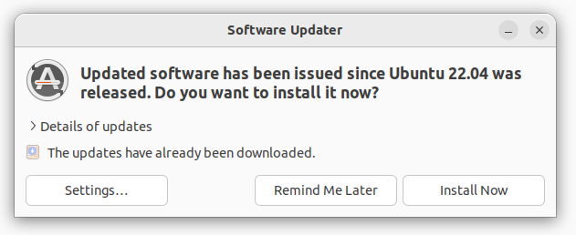
Instructions for Software Updates:
The updates shown in this screen are for the current version of Ubuntu (22.04) and will not install a new version of the operating system. These updates typically include security patches, bug fixes, and performance improvements.
You may proceed with installing these updates by clicking "Install Now", as they are not dangerous and will not affect the core compatibility of the lab environment. However, if you notice any unexpected behaviour after the updates, please inform your instructor or lab administrator immediately.
If you're unsure or prefer not to update at this time, you can choose "Remind Me Later" to skip this step for now.

Slide 19
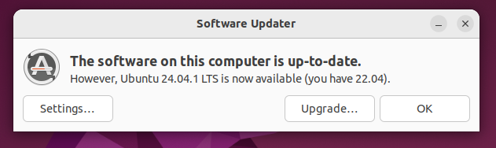
Important Instructions:
This screen notifies you that your system is up-to-date with the current version (Ubuntu 22.04) but also offers an option to upgrade to Ubuntu 24.04. Do not proceed with the upgrade at this time.
Upgrading to Ubuntu 24.04 will install a new version of the operating system, which may not be compatible with the software and configurations required for the lab tasks. To maintain a stable and functional lab environment, click "OK" to dismiss the notification and remain on Ubuntu 22.04.
If you have questions or think an upgrade might be required for your tasks, please consult your instructor before proceeding.

Slide 20
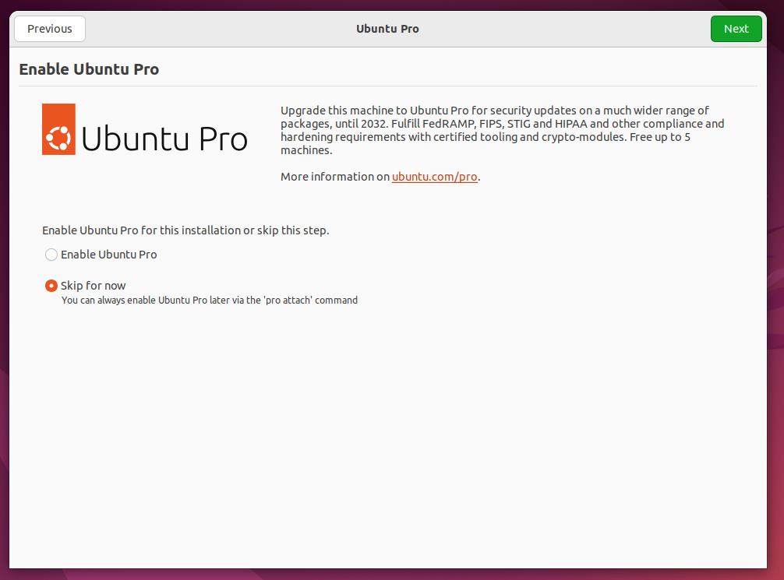
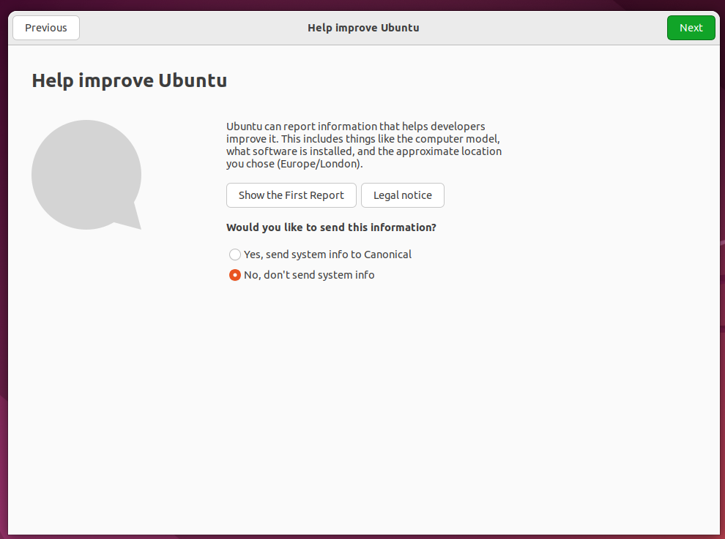
Click on Next to continue.

Slide 21
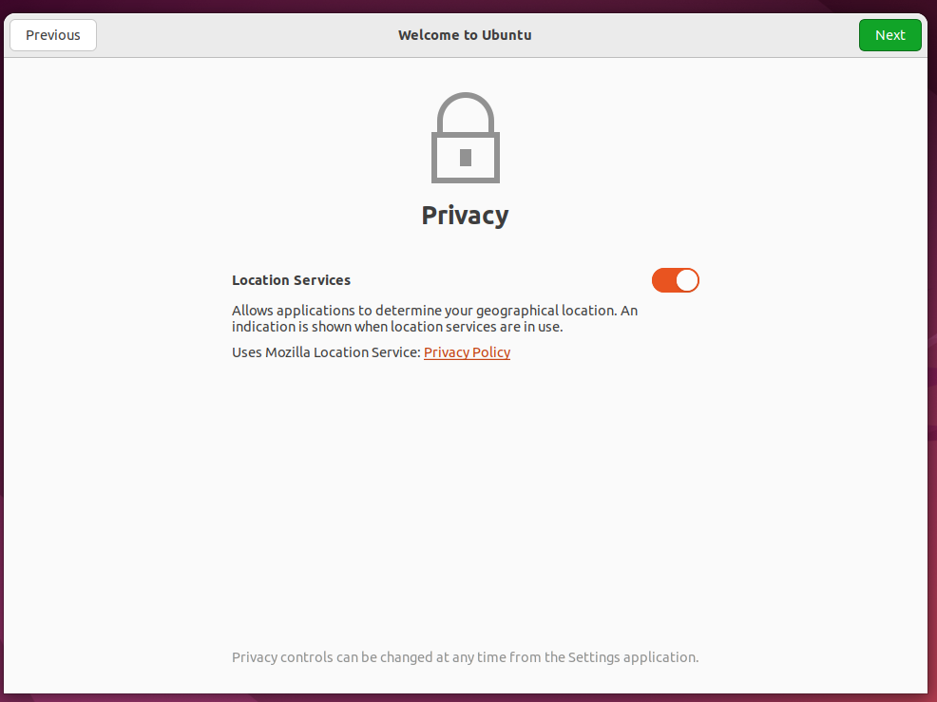
Click on Next to continue.

Slide 22
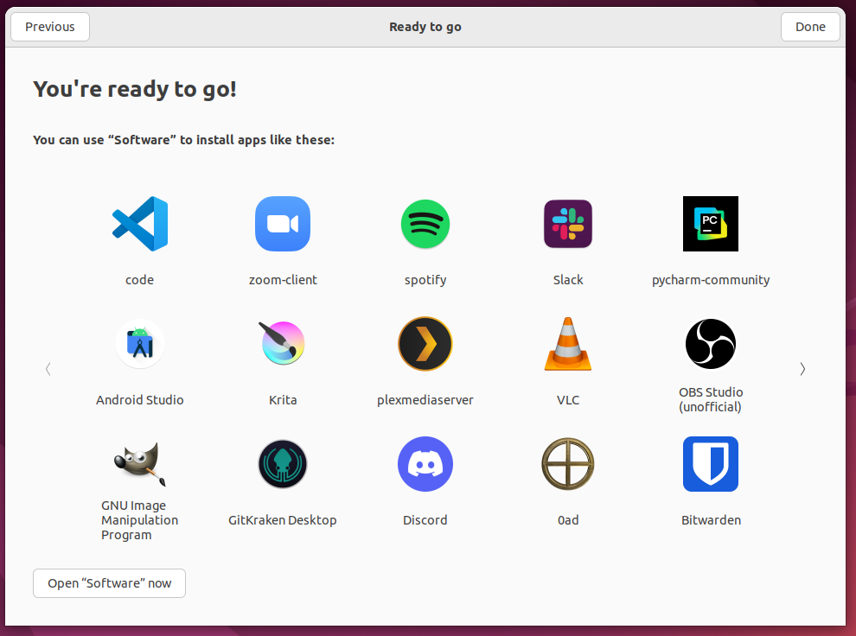
Click on Done to complete the setup.

Slide 23
Restarting Ubuntu
You can use the following commands to restart ubuntu from the terminal
sudo reboot
sudo reboot now
sudo reboot –f
sudo shutdown -r now
sudo shutdown -r
sudo shutdown -H
sudo shutdown +0
sudo systemctl reboot
Investigate the differences in these commands' options

Slide 24

NEXT STEPS

Slide 25
INSTALLATION OF UTILITY TOOLS
Type “Sudo apt-get update” . This needs to be done before any installation.
Type “sudo apt-get install wget” to be able to install applications from internet
Type “sudo apt-get install openssh-server” to be able to have a passwordless access from one machine to the other using ssh.
Type “sudo apt-get install vim” for good layout and colourful editing.
Type “sudo apt-get install open-vm-tools”
Type “sudo apt install net-tools”
Type “sudo apt update && sudo apt upgrade”
Type “sudo apt install ssh wget curl rsync net-tools vim nano unzip -y”
Type “sudo apt-get update” . This needs to be done before any installation.

Slide 26
Essential commands to install
sudo apt install -y build-essential curl wget git vim net-tools
This installs essential tools like compilers, file transfer utilities, version control, text editor, and network tools (`ifconfig`, `netstat`), ensuring the system is ready for development, troubleshooting, and basic networking tasks.
sudo apt install ssh wget curl rsync net-tools vim nano unzip –y
This installs tools for secure remote access (`ssh`), file transfers (`wget`, `curl`, `rsync`), network utilities (`net-tools`), text editing (`vim`, `nano`), and archive management (`unzip`), ensuring a versatile setup for development and system administration tasks.

Slide 27
Need to know and Few tips
Linux is case sensitive.
The password for the VM is “dde” and this is lower case.
CTRL + ALT +T => for opening terminal
lsb_release -a => check ubuntu version
cat /etc/hostname => to check the hostname of the VM.
touch to create a file named test1 e.g touch /home/dde/Desktop/test1. This creates the file on the desktop.
mkdir command to create new directory
rm /home/dde/Desktop/test1. This removes the created file (test1) from the desktop.
Type “clear” to clean off or clear the screen or clear the terminal.
scp /home/dde/Desktop/test1 dde@Machine02:/home/dde/Desktop. This can copy from one desktop to another once ssh is installed.
NOTE: dde is your specified username

Slide 28
Investigate the following Linux commands
history
who
ls
ls -l -a -t
echo $PATH
uname
uname -a
date
date +”%A, %B %d, %Y”
date +”%d/%m/%y”
pwd
hostname
sudo su

Slide 29
Unix/Linux Command Reference

Slide 30
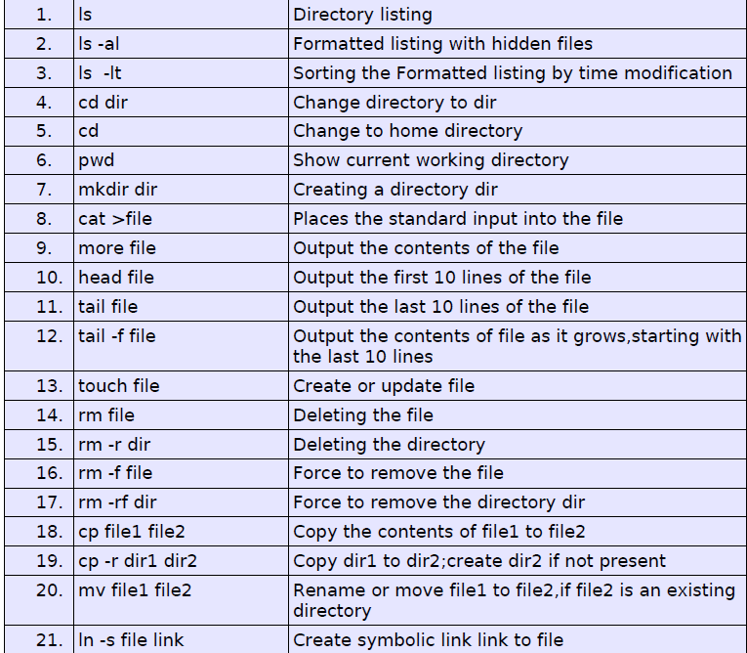
File Commands

Slide 31
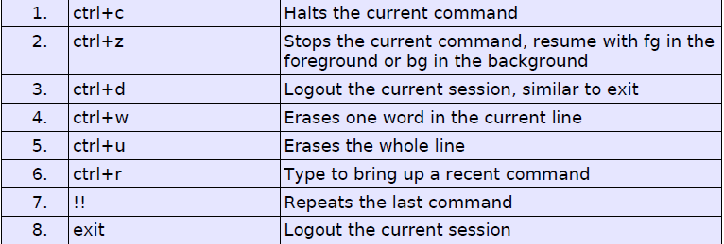
Some Linux Shortcuts

Slide 32
About Shells and Terminal Windows
Welcome to Ubuntu 20.04.1 LTS (GNU/Linux 5.4.0-47-generic x86_64)
* Documentation: https://help.ubuntu.com
* Management: https://landscape.canonical.com
* Support: https://ubuntu.com/advantage

